Slide 1
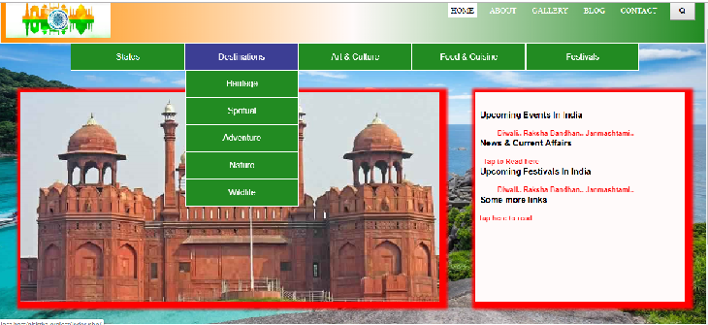
Home page index.php

Slide 2
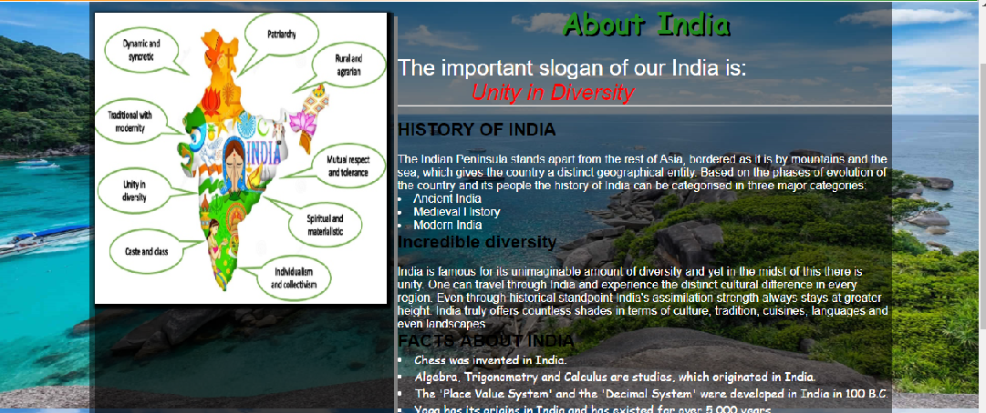
About Page: about.php

Slide 3
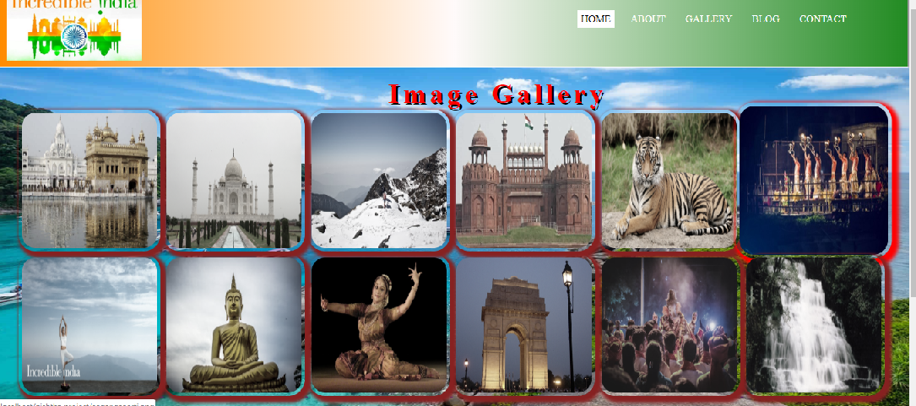
Gallery Page: gallery.php

Slide 4

Gallery Redirecting Page

Slide 5
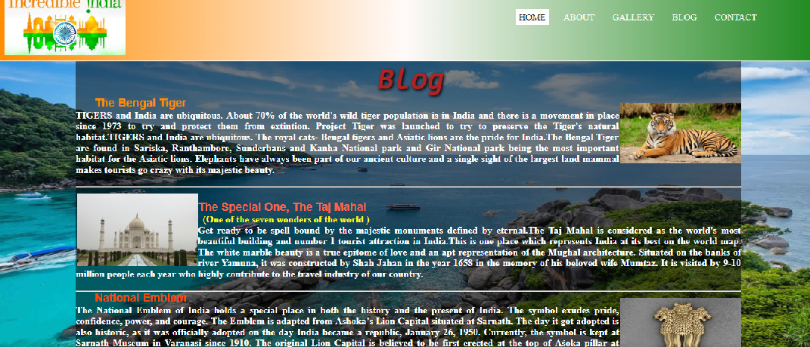
Blog Page: blog.php

Slide 6
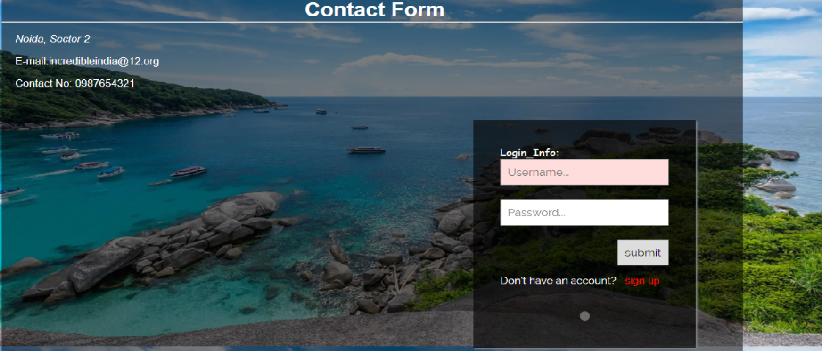
Contact page: contact.php

Slide 7
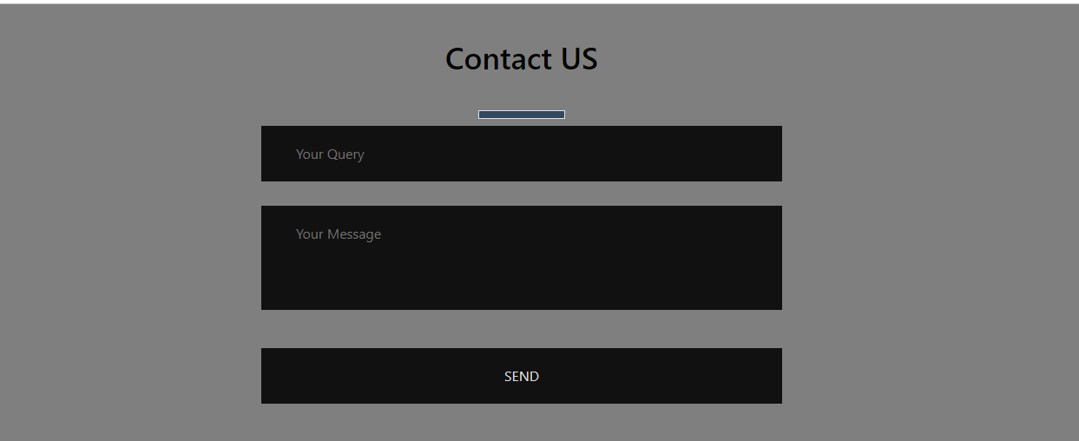
Contact Redirecting Page: query.php

Slide 8
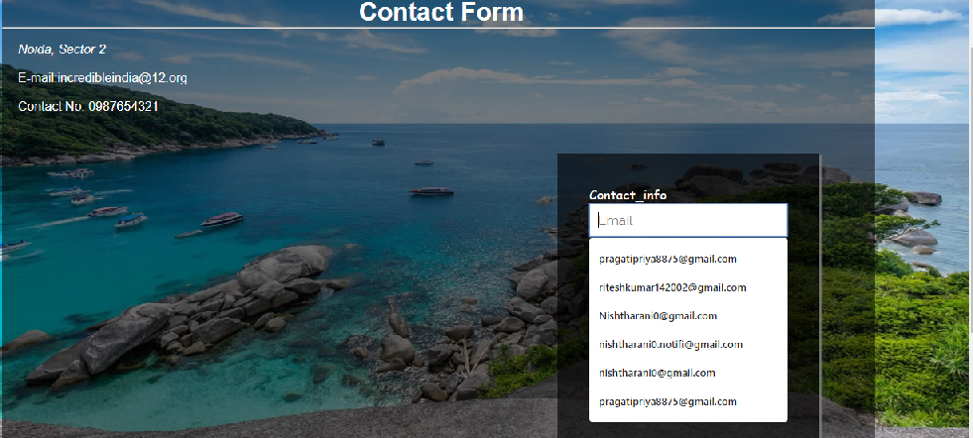
Contact page TO create new account (signup.php)

